Slide 1

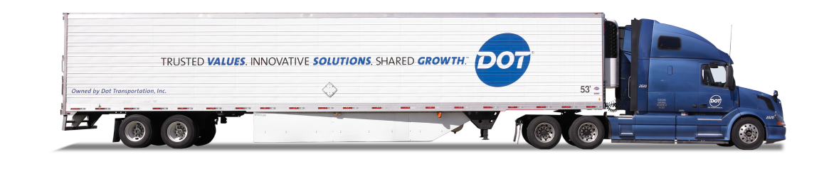
DOT FOODS
360 Sales Dashboard

Slide 2

AGENDA
POWER BI
DASHBOARD DESIGNS
CHALLENGES
FUTURE SCOPE
APPENDIX
INTRODUCTION
BUSINESS PROBLEM AND IMPORTANCE
ANALYTICAL METHOD
ANALYTICAL GOAL
CUSTOMER SEGMENTATION
Notes:
Here’s a quick overview of what we’ll cover today. We’ll start with an introduction to the company and our project scope. Then we’ll walk through the business problem and why it matters. After that, we’ll discuss our analytical methods, goals, and the customer segmentation approach we used. We’ll also showcase our Power BI dashboards, highlight key challenges we faced, and end with a look at future opportunities.

Slide 3
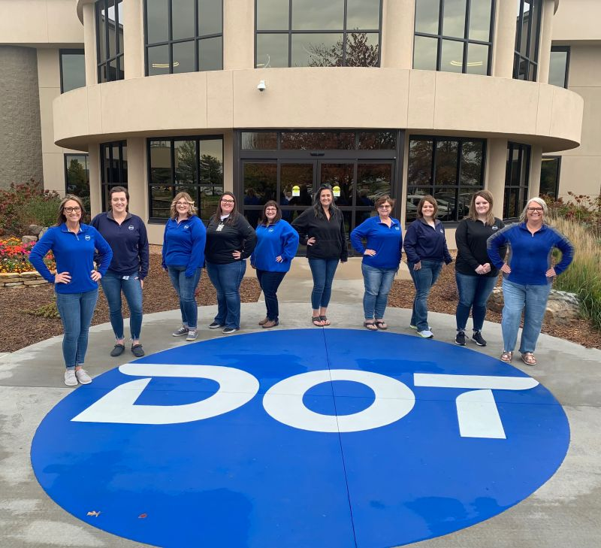

Introduction
Company Overview
Our project focuses on Dot Foods, the largest food redistributor in North America, connecting manufacturers and foodservice distributors for faster, more flexible deliveries across the U.S.
Project Scope
We developed a Power BI dashboard to provide real-time insights on customer behavior and order performance, supporting Dot Foods’ sales and logistics teams.
Urgency
Sales reps currently deal with fragmented data and manual processes. Our dashboard consolidates key metrics like dock time, PO count, and shipment volume, enabling quicker, data-driven decisions and better customer engagement.
Notes:
Right now, Dot Foods’ teams often struggle with scattered data sources and inconsistent customer segmentation. Sales reps rely on manual lookups, and there’s no single place to view performance metrics. Our dashboard aims to eliminate these inefficiencies by offering a unified view of key indicators such as dock time, purchase order volume, shipment frequency, and SKU diversity. Ultimately, this will help teams make quicker, smarter, and more strategic decisions..
Company Overview
Our project centers on Dot Foods, the largest food redistributor in North America. They serve as a bridge between manufacturers and foodservice distributors, enabling faster, more flexible deliveries across the U.S.
Project Scope
We developed a Power BI-based 360 customer and order performance dashboard. The goal is to support Dot Foods’ sales and logistics teams with interactive, real-time insights on customer behavior and shipment efficiency.
Why This Matters
Currently, sales reps face fragmented data sources, manual lookups, and inconsistent customer segmentation. Our dashboard solves this by delivering an integrated view of key metrics like dock time, PO count, shipment volume, and item diversity, enabling better decision-making, faster response times, and more strategic customer engagement.

Slide 4
Business problems & importance
Business Requirement
Dot Foods lacked a consolidated system to compare performance across different customer tiers. Important insights like which cause longer dock times or has low order density were buried in raw data.
Why It Matters
Operations couldn’t identify high-friction accounts that slow down dock throughput.
Sales lacked visibility into key accounts vs. underperforming clients.
Strategic decisions around resource allocation and service prioritization were made without objective metrics.
Deliverables
A dashboard that benchmarks key KPIs across tiers, making customer performance transparent and actionable.
Notes:
The sales teams didn’t have a clear way to compare customer performance across tiers. Important insights like which accounts caused the longest dock delays or had the lowest order density were buried deep in raw data.
This lack of visibility had real consequences: Operations couldn’t flag high-friction accounts that slowed throughput, Sales struggled to distinguish top-performing clients from underperformers, and strategic decisions around resource allocation were made without hard data.
So, we built a performance benchmarking dashboard — a unified, visual tool that tracks key KPIs across customer segments. It empowers every team to see what’s working, where the friction lies, and how to act on it.
The result? Greater transparency, smarter decisions, and a direct line of sight into customer impact

Slide 5




Proposed Solutions
Machine Learning Model for Customer Analysis:
Apply a K-Means clustering algorithm to segment customers into 4 distinct groups based on their purchase behavior
Classify customers more effectively, uncover patterns, and provide tailored insights to support strategic decision-making
Dynamic Data Visualization Tool:
Create a dynamic visualization tool (Power BI)
Use different filter variables such as customer number or tier level to explore customer purchasing behavior
The dashboard supports peer comparison, tracks historical trends, and empowers data-driven decision-making
Notes:
1. machine learning model for customer analysis
2. dynamic visualization tool using Power BI

Slide 6
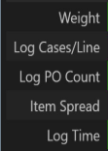
Customer Segmentation Goals
Use K-Means clustering to segment customers based on sales behavior
The goal is to identify distinct customer profiles to optimize operations and enhance strategic decision-making
Target Variable & Key Features:
Segment Customers Based on Metrics
Success criteria:
Clear visual separation
2. Business interpretability for each cluster
Notes:
1. K - means clustering to segment cutomer
2. dont have target variable. because we use unsupervised learning. we have 5 key features
3. clear visual separation/ business interpretability

Slide 7
Power BI Dashboard Goals
Key insights:
Consistency & Performance Tracking:
The dashboard monitors key logistics metrics like Dock Time, Cases per Load, PO Count, and Item Spread across 13 time periods, enabling trend analysis.
These help assess loading efficiency, shipment density, and SKU diversity per customer.
Tier-Based & Company-Level Benchmarking:
Visuals show performance comparisons across Tier types (e.g., Tier I, II, Corporate) and help identify top/bottom companies by shipment volume.
Notes:
1. consistency and performance tracking for customers
2. tier based and company level benchmarking to see the different group behaviors
3.we detect the bottlenecks using several factors
How?
1. identify different customer purchase behavior
2. sales team can do better source planning

Slide 8
Power BI Dashboard Goals
Bottleneck Identification:
Heatmap-style tables visually highlight clients with slow dock times, high SKU complexity, or low vehicle efficiency, aiding in bottleneck detection.
Empower business outcomes:
1. Identify customer purchasing information
2. Support resource planning
3. Drive better data-driven decisions
Notes:
1. consistency and performance tracking for customers
2. tier based and company level benchmarking to see the different group behaviors
3.we detect the bottlenecks using several factors
How?
1. identify different customer purchase behavior
2. sales team can do better source planning

Slide 9
Customer Segmentation
Column | Mean | Std | Min | 25% | 50% | 75% | Max
Weight | 16879.01 | 11993.26 | 6223.00 | 13827.00 | 13827.00 | 26767.00 | 145469.00
Cases | 1440.22 | 1133.49 | 0.00 | 460.00 | 1173.00 | 2200.00 | 10900.00
Lines | 96.75 | 100.43 | 1.00 | 25.00 | 69.00 | 135.00 | 1080.00
Pallets | 9.40 | 8.51 | 1.00 | 2.00 | 7.00 | 15.00 | 122.00
Cases/Line | 38.14 | 111.52 | 1.00 | 9.28 | 16.70 | 32.69 | 6160.00
PO Count | 5.06 | 7.40 | 1.00 | 1.00 | 1.00 | 6.00 | 112.00
Item Spread | 0.06 | 0.06 | 0.00 | 0.03 | 0.05 | 0.08 | 1.00
Dock Time (Hours) | 2.87 | 2.83 | 0.00 | 0.80 | 2.04 | 4.24 | 23.99
Volume: 91,999 observations across multiple features, providing a comprehensive dataset for analysis.
Preprocessing: Invalid values (e.g., nulls in PO Count, negative values) were removed to ensure data integrity.
Challenges: Some features exhibit skewed distributions, which may require transformation for more accurate modeling. This is evidenced by the large differences between the mean and standard deviation (e.g., Weight and Cases), extreme variations in standard deviations (e.g., Weight and Dock Time), and the significant distance between Min/Max values and the mean or median (e.g., Cases and Dock Time).
Notes:
We started with a large dataset containing around 92,000 records. In the data preprocessing phase,it’s clear that variables like weight or time should never be negative or null. So we removed all records with missing and negative values in these fields.
A key challenge was that after plotting the data, we discovered many features were highly skewed, and in some cases, contained outliers. This could seriously distort clustering results.

Slide 10
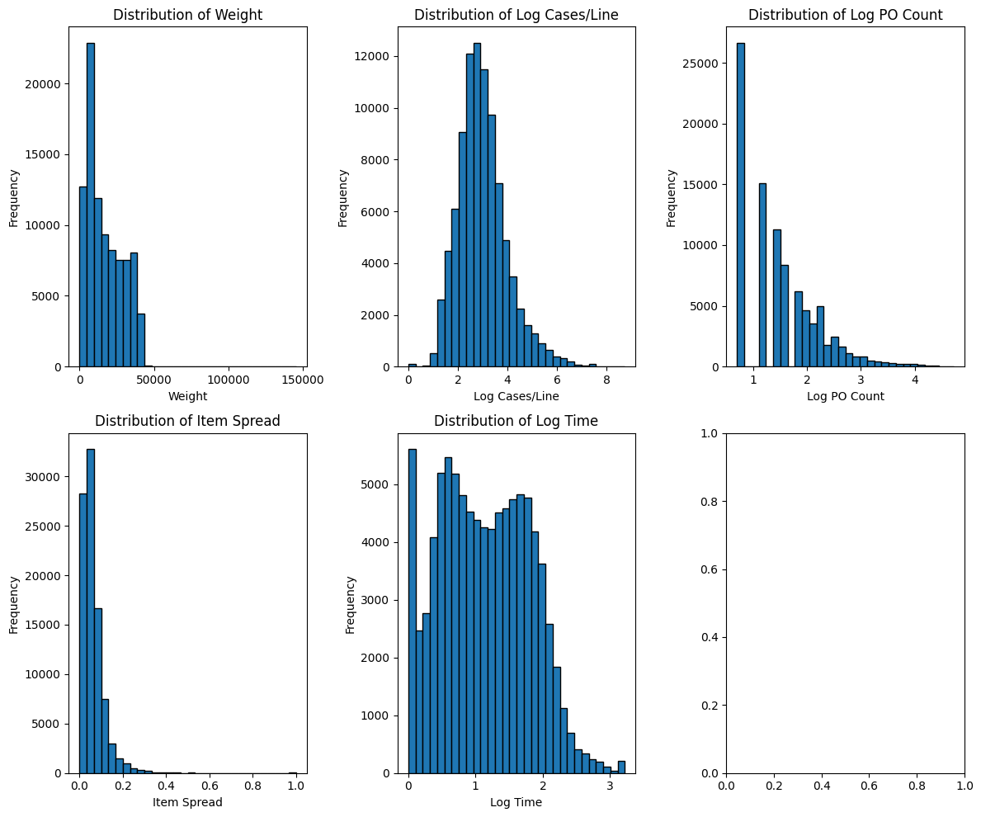
Customer Segmentation
Preprocessing: Outlier capping using IQR method across key numeric columns
Applied log transformation to skewed features: Cases/Line, PO Count, Dock Time
Notes:
To address this, for heavily skewed features such as "Cases per Line", "PO Count", and "Dock Time", we used log transformations.
we selected five representative variables that captured the most meaningful operational differences across clients. These became the basis for our clustering analysis.

Slide 11
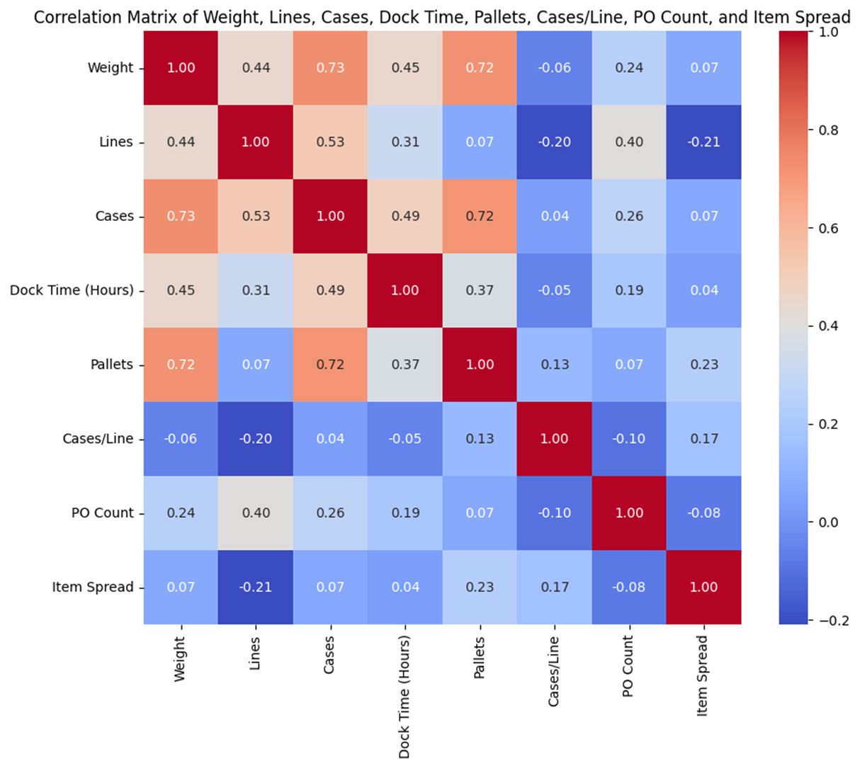
Customer Segmentation
Focus on 5 most representitive variables to do further cluser analysis
Notes:
For ouliers, we use

Slide 12
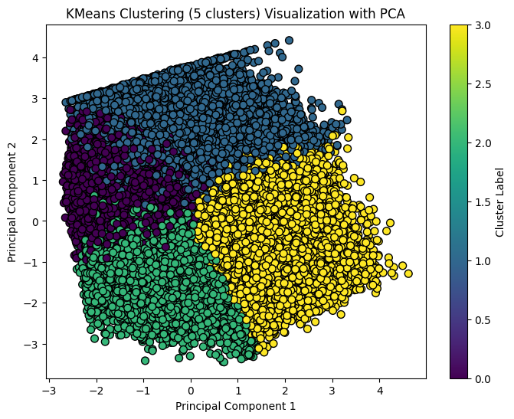
Customer Segmentation
Cluster: KMeans algorithm to segment the dataset based on five key features.
4 clusters are clearly separated, forming well-defined and interpretable groups.
PCA factors: The factor loading matrix for the first two principal components (PC1 and PC2), with red and green used to highlight strong negative or positive contributions

Slide 13
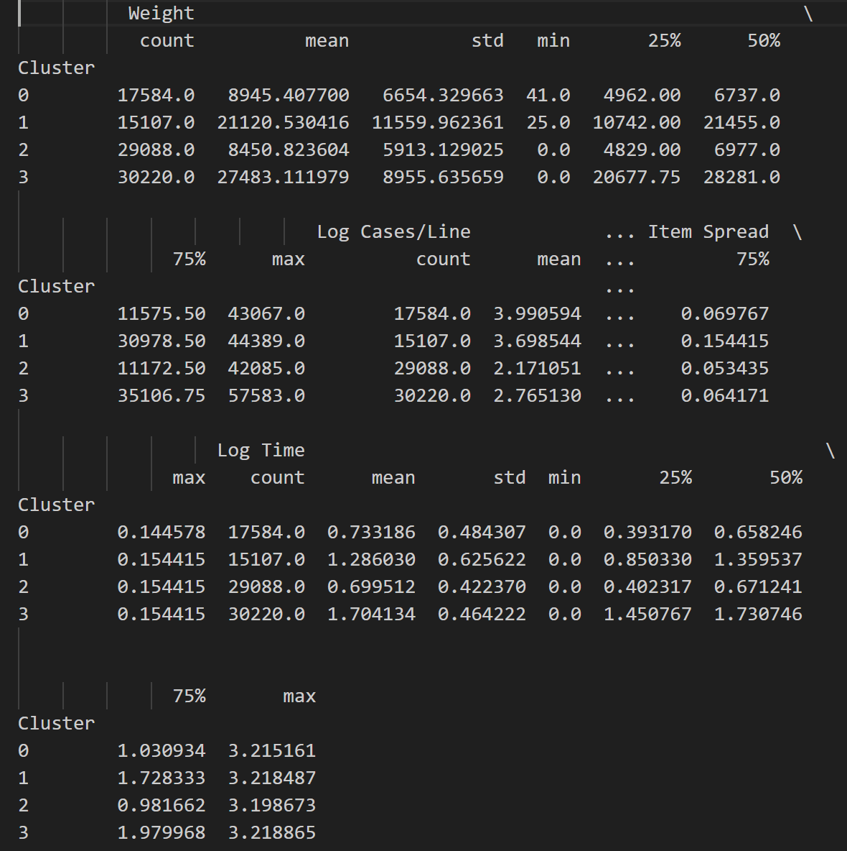
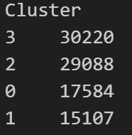
Customer Segmentation
Cluster 0: Small-to-Medium Volume Clients with Fast Loading and Large Single Orders
Cluster 1: Medium-to-High Volume Clients with Stable Orders and Moderate Vehicle Distribution
Cluster 2: Low-Volume, Infrequent Clients with Small Orders and Fast Turnaround
Cluster 3: Strategic Clients with Extremely High Volume, High Order Frequency, and Complex Loading

Slide 14

DASHBOARD-OVERVIEW
Objective:
Build a 360° sales performance view for Dot Foods, focusing on dock time, order metrics, and customer tiers.
Solution Type:
Interactive Power BI dashboards segmented by period, tier, and company performance.
Key Benefits:
Real-time slicing by customer, tier, region, and period
Tier-based benchmarking for strategic decision-making
Fast identification of outliers and optimization areas

Slide 15
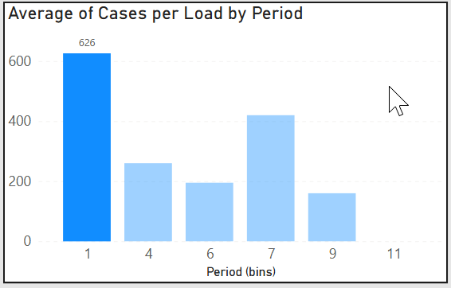
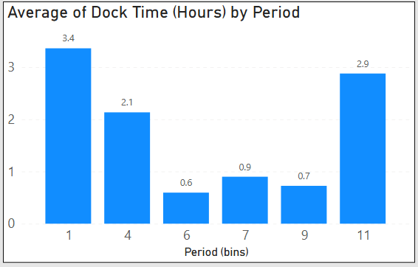
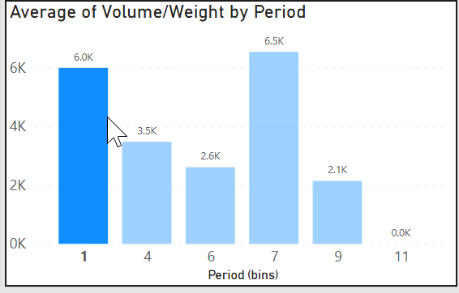
Period Dashboard
Filterable Performance Over Time
Users can filter the dashboard by key dimensions such as company, customer type, sales tier, region, time-period, year
All charts and metrics respond automatically to selected filters for real-time insights
The dashboard tracks KPI trends over time to identify patterns and ensure performance consistency
Operational metrics such as processing time, volume, and efficiency are monitored for seasonal or regional variations

Slide 16


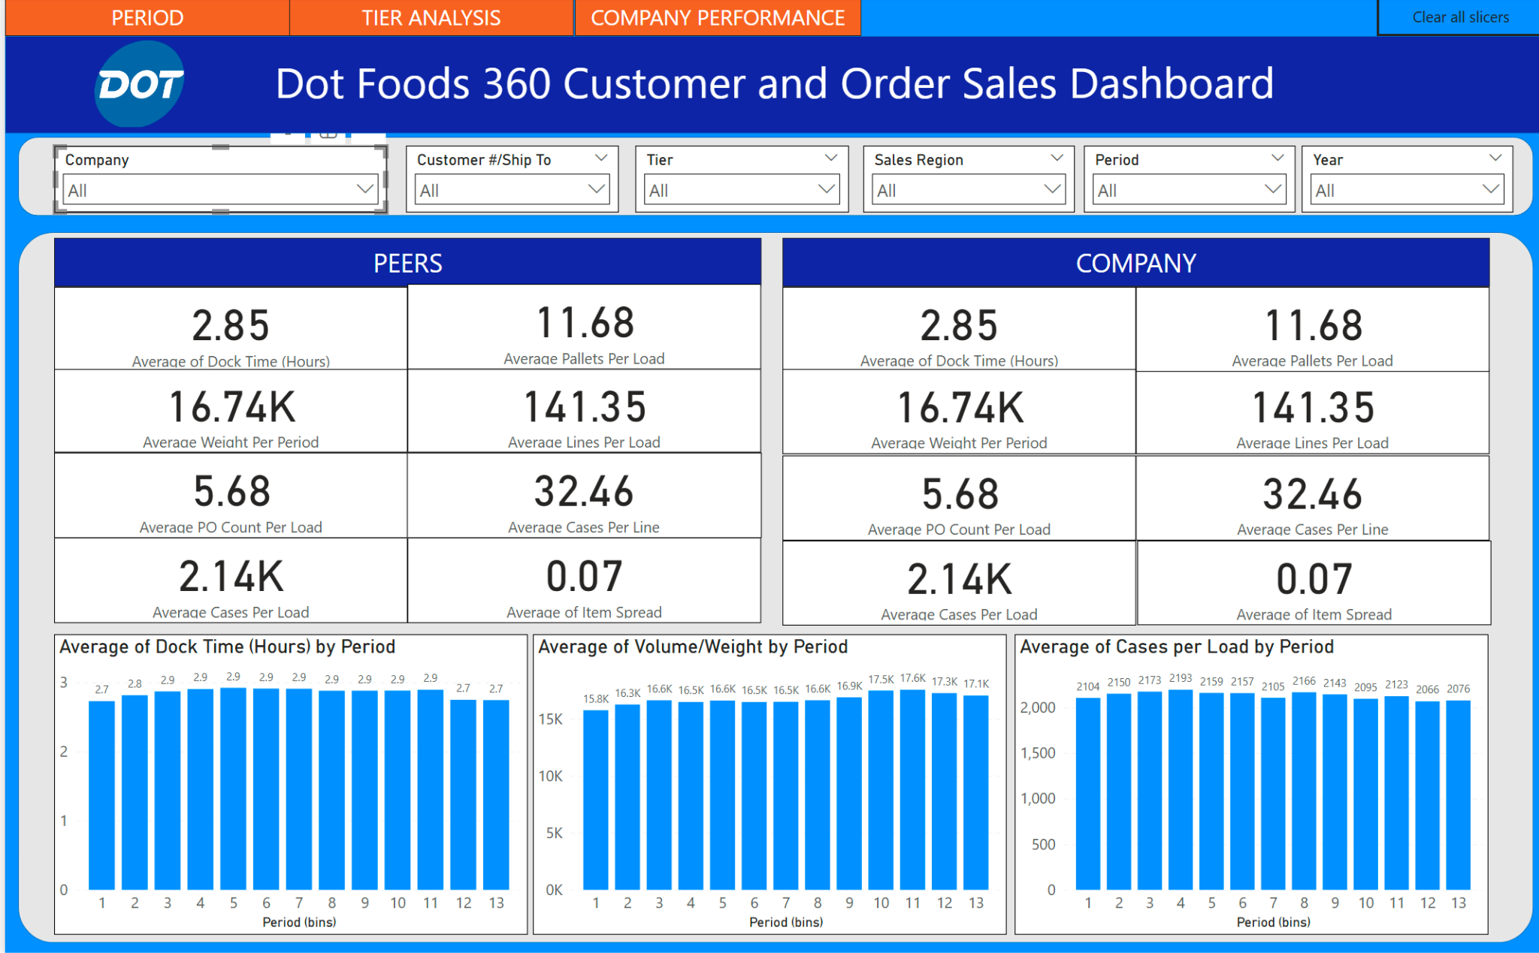

Slide 17

Tier Dashboard
Compare Operational Efficiency by Customer Tier
Filters: Tier, Year, and Period (top of dashboard)
Below charts update dynamically based on selections
Key metrics by customer tier:
Dock Time
PO Count
Weight & Volume
Item Spread
Helps benchmark operational performance across segments

Slide 18
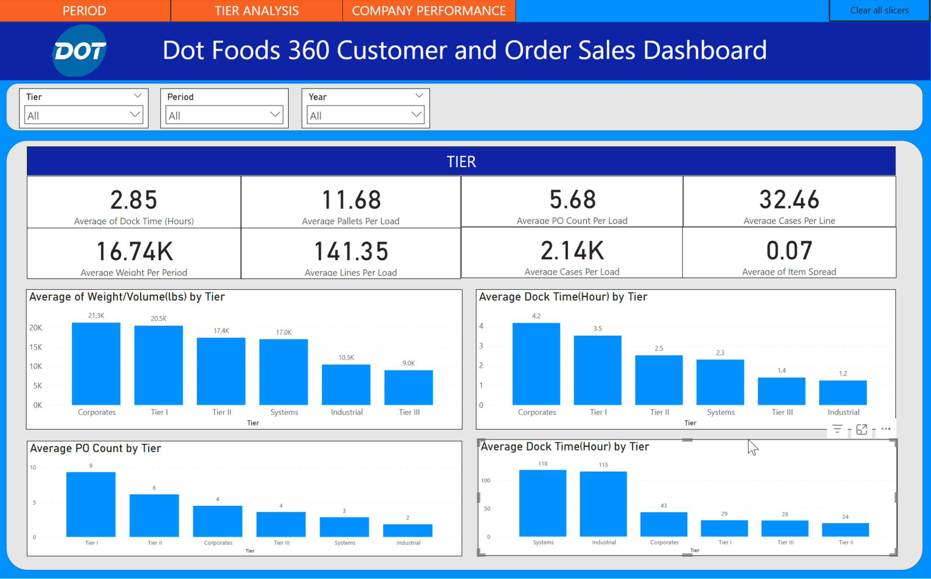
Tier Dashboard
Tier segmentation allows for performance benchmarking across customer types based on Weight/Volume. (e.g., Tier I, II, III, Corporate, etc.)
Separate visuals highlight the Top and Bottom companies by shipment volume—this aids in identifying key partners and low-volume outliers.
Useful for strategic account management, resource allocation, and prioritizing high-impact clients.
f
Notes:
The second page of the dashboard compares performance across customer tiers, like Tier I, II, III, and Corporate.
It shows how shipment size and dock times vary, helping us benchmark efficiency by customer type.
We also highlight the top and bottom companies by shipment volume.
This helps identify key partners to prioritize any outliers that may need attention.

Slide 19
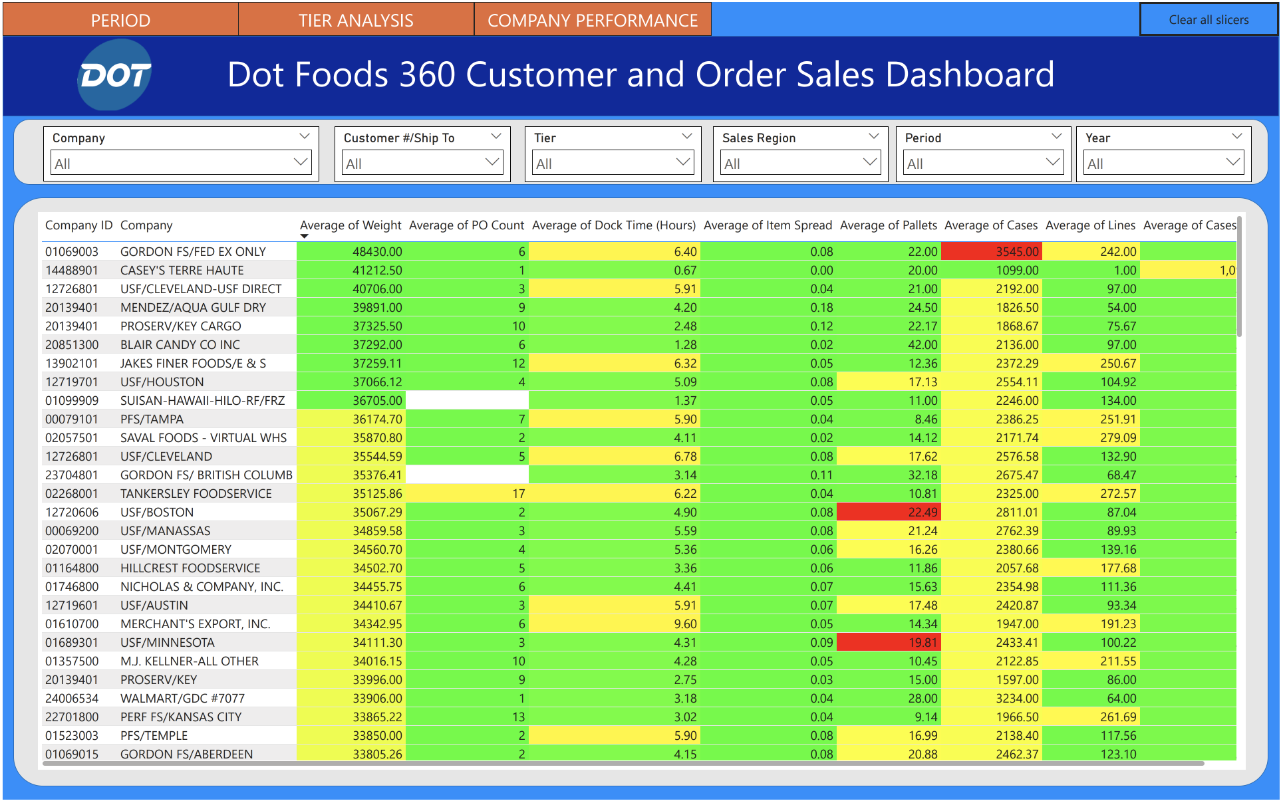
Company Dashboard
Variables like PO Count, Dock Time, Item Spread, Pallet Count, Case Count, and Line Items are tracked for each customer.
This enables multi-dimensional performance assessment per customer—across efficiency, load density, and SKU diversity.
Helps uncover operational bottlenecks, optimize loading strategies, and improve partner-specific logistics.
Notes:
Here, we take a dive into detailed metrics for each customer
We focus on variables like dock time, case count, PO count, and more.
The client requested that we color code the data.
This view helps pinpoint inefficiencies and tailor strategies per partner, making our operations more efficient and our customer relationships stronger.”

Slide 20



Challenges And Learnings
Technical Learnings & Challenges
Understanding the Dashboard Development Lifecycle
Creating Functional Dashboard Mockups
Managing Technical Aspects of the Project
Building Data Models using DAX and Performing ETL in Power BI
Business Learnings & Challenges
Gathering and Interpreting Business Requirements
Defining Scope, Deliverables, and KPIs
Translating Business Needs into Technical Solutions
Soft Skills Development
Coordinating Cross-Functional Project Teams
Distributing Workload Effectively
Managing Stakeholder Expectations and Communication

Slide 21
Future Scope
Datamart Storage and Processing
Dashboard Visualization
Insights Review and Feedback from Client
Client Uploads New Data
ETL from Data Lake to Datamart
Improvements
Engage students earlier in the data pipeline, particularly during the ETL stage
Automate dashboard deployment by uploading PBIX files to Docker and integrating scheduling with Power Apps
Long-Term Vision
Encourage experimental data exploration and use of machine learning models
Treat dashboarding as a foundational step toward more advanced analytics
Evolve the process toward complex predictive and prescriptive analytics

Slide 22
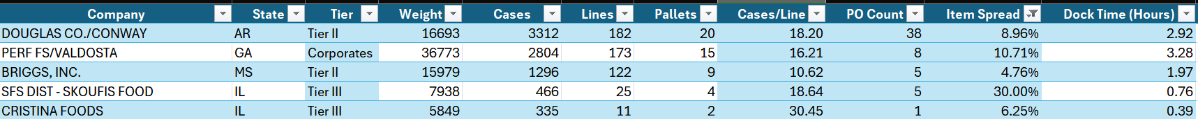
Appendix
Table Overview:
Weight: The total weight of the products handled
Cases: The number of cases handled
Lines: The number of product lines
Pallets: The number of pallets processed
Cases/Line: The number of cases per line
PO Count: The number of purchase orders
Item Spread: The distribution of products across items
Dock Time (Hours): The time taken for docking operations
Metrics in Focus:
Five Key Metrics: These include Weight, Docking Time, Item Spread, and more, essential for performance analysis.
Docking Time: The total time taken for docking and processing goods.
Item Spread: Indicates how diversified the items are in terms of volume and variety.
This table supports the analysis by providing foundational operational data that aids in assessing process efficiency, resource allocation, and performance across different companies.

Slide 23
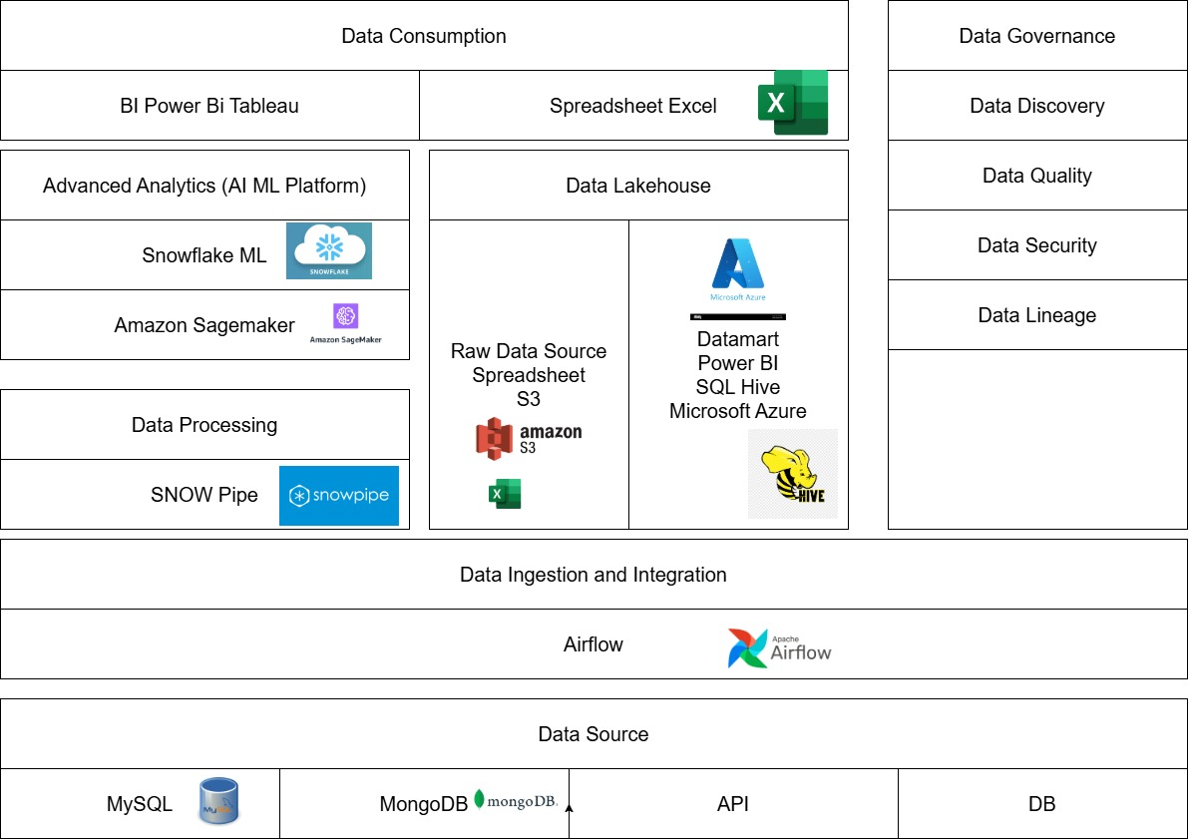
Appendix

Slide 24



THANK YOU!
DOT FOODS

